Slide 1



HOME
SERVICE
CONTACT
SNORT
INTRUSION DETECTION SYSTEM

Slide 2



ABOUT
SERVICE
CONTACT
CONTENT
PART 1 : FUNDAMENTALS OF SNORT
Introduction
Rule
Snort Architecture
PART 2: PRACTICAL
Installation
Configure Snort Rule
Intrusion Detection with Snort

Slide 3
PART 1: FUNDAMENTALS OF SNORT

Slide 4

ABOUT
SERVICE
CONTACT
Introduction
  Snort is an open-source network intrusion detection and prevention system (IDS/IPS) that monitors network traffic and identifies potentially malicious activities on Internet Protocol (IP) networks.
  Originally developed by Martin Roesch in 1998 and is now maintained by Cisco’s Talos Security Intelligence and Research Group.

Slide 5
ABOUT
SERVICE
CONTACT
  Snort detects malicious traffic or attacks by leveraging pattern matching.
  When active, Snort captures packets, reassembles them, analyzes them and determines what needs to be done to the packet based on predefined rules.
  Snort rules are very similar to a typical firewall rule, whereby, they are used to match network activity against specific patterns or signatures and consequently make a decision as to whether to send an alert or drop the traffic (in the case of IPS).

Slide 6
ABOUT
SERVICE
CONTACT
Snort Features
SIGNATURE-BASED DETECTION
FLEXIBLE RULE LANGUAGE
  Uses predefined rules (signatures) to identify known attacks.
  Admins can write custom rules for specific threats or policies
PACKET SNIFFER
PROTOCOL ANALYSIS
  Captures and monitors network traffic in real time.
  Understands and analyzes network protocols(TCP, UDP, HTTP, etc.).
PACKET LOGGER
CROSS-PLATFORM SUPPORT
  Saves network traffic to files for later analysis.
  Runs on both Linux and Windows

Slide 7
SNORT ARCHITECTURE

Slide 8
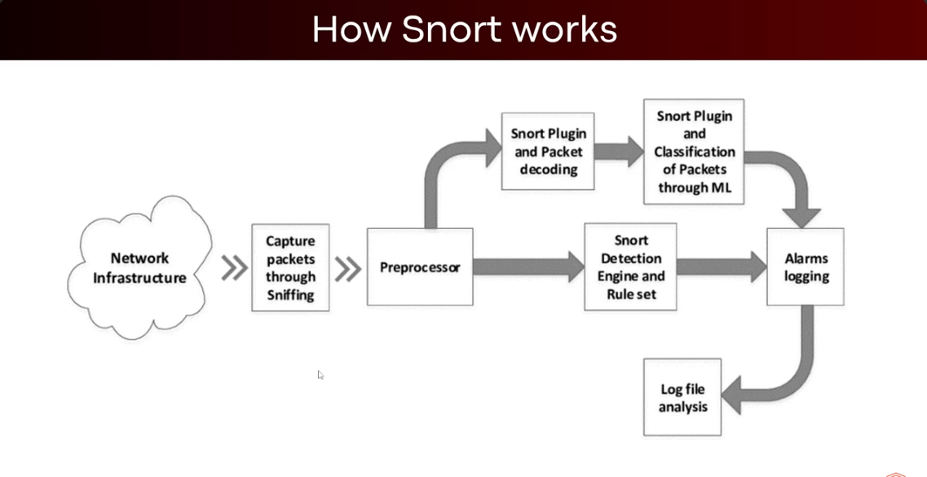

Slide 9
NETWORK INFRASTRUCTURE
SNORT PLUGIN & MACHINE LEARNING CLASSIFICATION (OPTIONAL)
  Snort sits on a network and monitors all traffic that flows through it.
  This traffic can be legitimate (normal use) or malicious (attacks, scans, exploits).
  Some advanced Snort deployments use machine learning to classify packets and detect new or unknown attacks.
  This complements rule-based detection by identifying patterns not explicitly written in rules.
CAPTURE PACKETS THROUGH SNIFFING
  Snort works like a packet sniffer (similar to Wireshark).
  It captures raw packets from the network for inspection.
ALARMS LOGGING
  If malicious or suspicious activity is detected, Snort logs an alert.
  Alerts can be sent to the console, stored in log files, or forwarded to a SIEM (e.g., Splunk, ELK stack).
PREPROCESSOR
  Before analysis, the packets go through a preprocessor.
  This step normalizes the traffic (removes noise, reassembles fragmented packets, detects anomalies).
LOG FILE ANALYSIS
SNORT PLUGIN AND PACKET DECODING
  Security analysts review logs and alerts.
  Helps in incident response, forensic analysis, and tuning Snort rules
  Plugins decode packet headers and payloads (IP, TCP, UDP, ICMP, etc.).
  This makes it easier for Snort to understand what each packet is carrying.

Slide 10
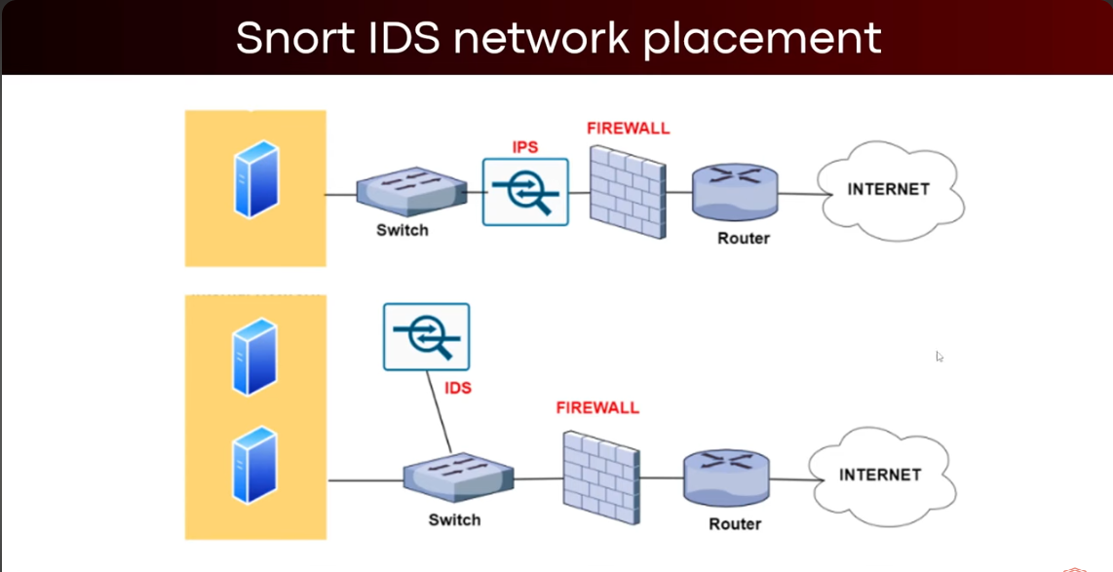

Slide 11

ABOUT
SERVICE
CONTACT
TOP PART - IPS
DIAGRAM EXPLAINATION
  Snort is acting as an IPS
  The IPS sits in-line (directly in the traffic path).
  It inspects packets in real time
  If it detects malicious traffic, it can block or drop it immediately before it reaches the firewall or router.
BOTTOM PART - IDS
  Snort is acting as a passive IDS.
  The IDS monitors copies of network traffic from the switch.
  It inspects packets in real time
  It detects and alerts about suspicious activities but cannot block traffic directly
  The firewall or admin must take action manually or through automation..

Slide 12
SNORT RULES

Slide 13



ABOUT
SERVICE
CONTACT
Snort Rules
COMMUNITY RULES
REGISTERED RULES
SUBSCRIPTION ONLY RULES
  Require active paid subscription in order to be accessed and used
  Get latest rule as soon as the rules released
  Used by Company and Security Team
  Basic rules to get started
  Free rule-sets
  Created by Snort Community
  Free Rule-sets
  In order to use, Need to register for an account
  Created by Cisco Talos

Slide 14
PART 2: PRACTICALS

Slide 15
INSTALLATION

Slide 16
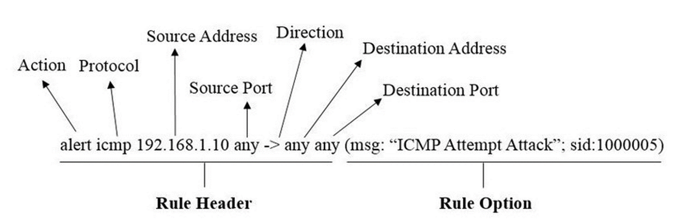
Snort Rule Syntax
*Refer to the Snort Rule Documentation for more information

Slide 17
ABOUT
SERVICE
CONTACT
Explaination
RULE HEADER
SUMMARY
The rule header defines the basic matching criteria for the rule essentially the "when and where" to trigger the rule.
  Rule Header = The conditions for which packets are examined.
  Rule Option = The specific details and actions once those packets match.
RULE OPTION
The rule option specifies detailed conditions for matching and what action to take essentially the "how" and "why" of the rule. It is enclosed in parentheses (...) and contains option keywords separated by semicolons.

Slide 18

Thank You

